Slide 1
Cognizance ’23
Workshop on One API_Intel
Presentation on Pokémon API using Stream lit and Plotly

Slide 2
Let’s See what Stream lit is?
Streamlit is an open-source Python library that allows developers to create interactive web applications with simple Python scripts. It is designed to make it easy for data scientists and machine learning engineers to create data-driven web applications without having to learn web development languages like HTML, CSS, and JavaScript.
With Streamlit, developers can create interactive data visualizations, charts, and dashboards with a few lines of code. The library provides pre-built UI elements that can be customized to fit specific use cases. It also provides real-time feedback, so developers can see changes to their applications as they make them.

Slide 3
What is SYCL
SYCL is a C++ programming model for heterogeneous systems. It allows developers to write C++ code that can be executed on a wide variety of computing devices, including CPUs, GPUs, and FPGAs.
SYCL is based on standard C++ and provides a single-source programming model. This means that developers can write their code once and then target multiple devices without having to write separate code for each device.
SYCL is built on top of OpenCL, a low-level API for heterogeneous computing. SYCL provides a higher-level abstraction that is easier to use and more portable than OpenCL.

Slide 4
Project 1 - Pokemon API
The Pokémon API is a RESTful API that provides access to data about the Pokémon universe, including information about Pokémon species, moves, abilities, games, and more. It is maintained by PokéAPI, a community-driven project that aims to provide a free, open-source resource for developers to use in their Pokémon-related projects.
Here are some key features of the Pokémon API:
Pokémon species: The API provides data on over 800 Pokémon species, including their names, types, abilities, stats, and more.
Moves: The API provides data on over 700 moves, including their names, types, power, accuracy, and more.
Abilities: The API provides data on over 200 abilities, including their names, effects, and which Pokémon can have them.
Games: The API provides data on various Pokémon games, including their names, release dates, and platforms.

Slide 5
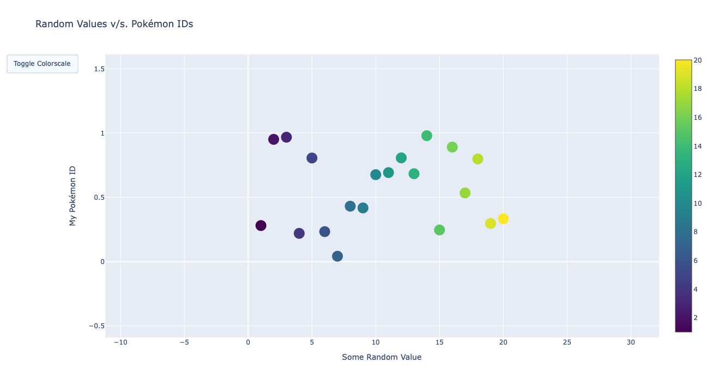

Slide 6
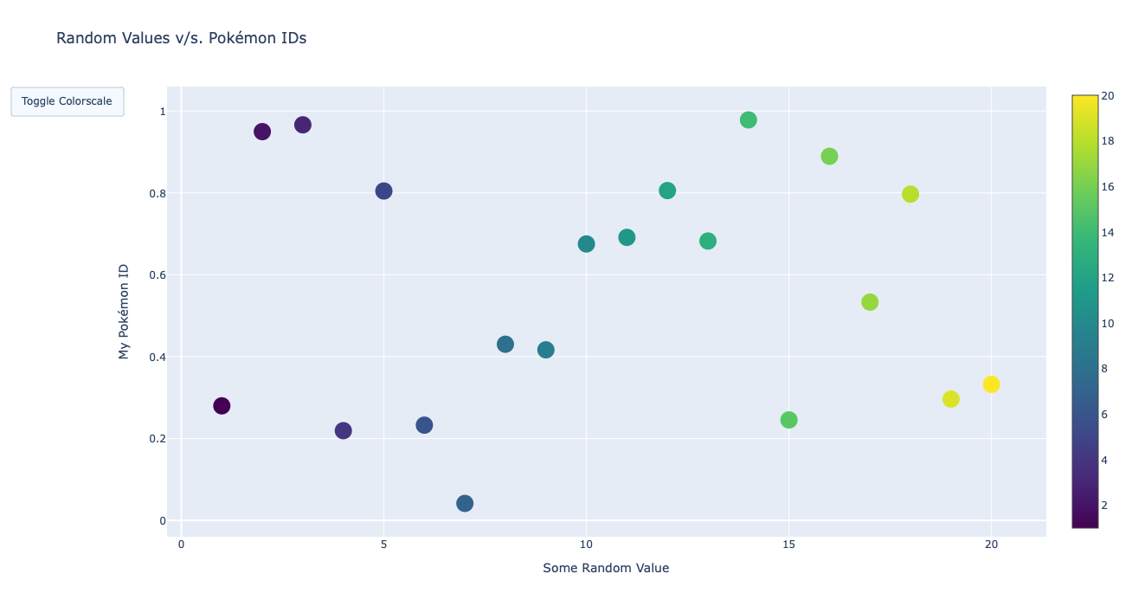

Slide 7
You Can Excess the Code below
https://github.com/ashwani3206/Pokeman_api-Intel.git

Slide 8
Project 2 - Font Detection Using Image Classification
Font detection using image classification is the process of identifying the font used in a given image of text. This can be useful in a variety of applications, such as identifying the font used in a logo or analyzing typography in design.
Here are the steps involved in font detection using image classification:
Data Collection: Collect a large dataset of images containing text in various fonts. This dataset can be created by scraping images from the internet or by capturing images of text in the wild.
Data Preprocessing: Preprocess the dataset by resizing the images, normalizing the pixel values, and converting the images to grayscale.
Model Training: Train a convolutional neural network (CNN) on the preprocessed dataset. The CNN should be trained to classify images of text into different font categories.

Slide 9
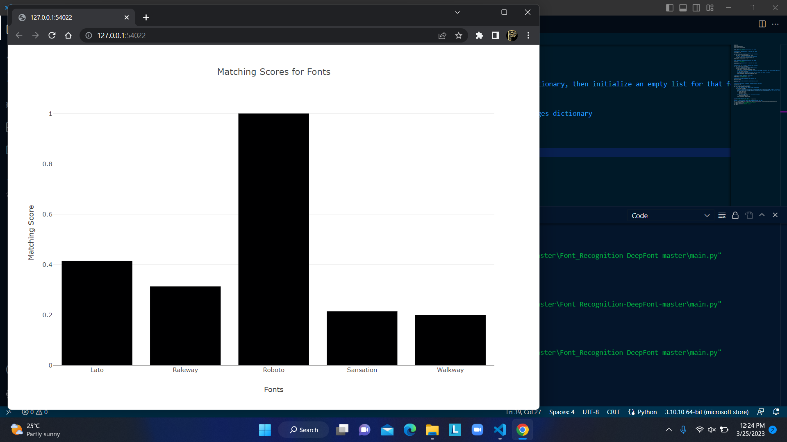

Slide 10
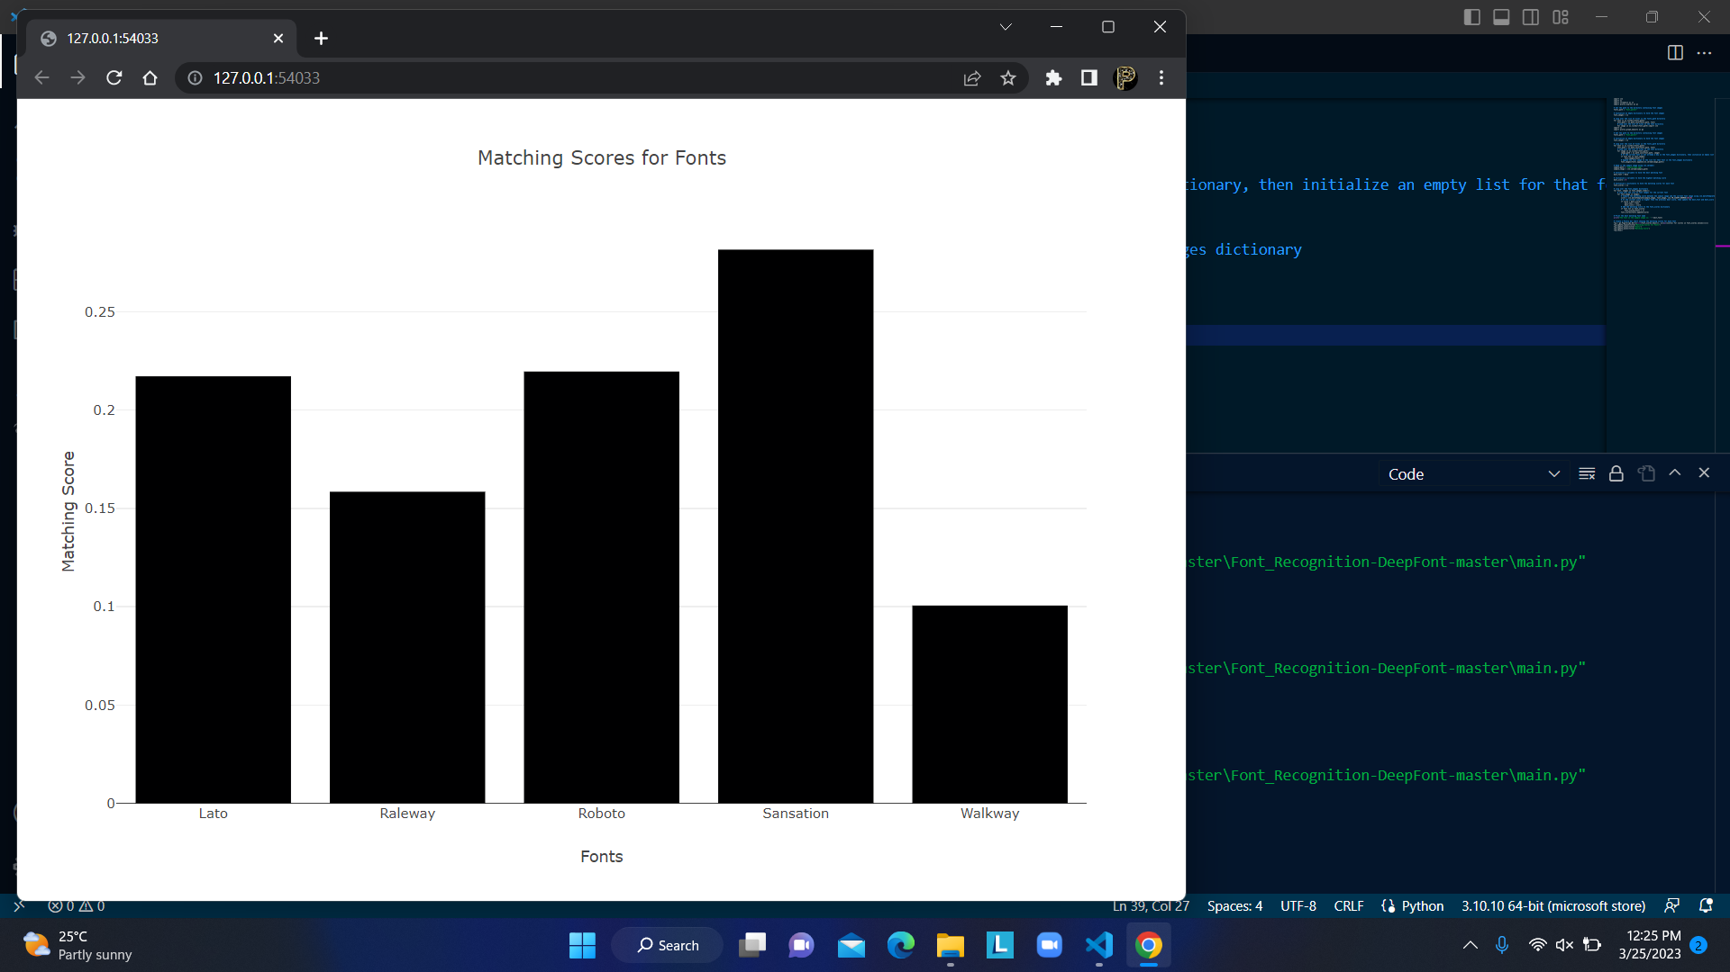

Slide 11
Thanks

